Slide 1
Anomaly Detection
Zhu yiling
Notes:
https://github.com/Dai7Igarashi/Anomaly-Detection

Slide 2
Anomaly Detection
Autoencoders, variational autoencoders (An & Cho, 2015; Zhou & Paffenroth, 2017), energy based models (Zhai et al., 2016) and deep autoencoding Gaussian mixture models (Bo Zong, 2018) have been explored for anomaly detection

Slide 3
OCGAN: One-class Novelty Detection
Notes:
https://zhuanlan.zhihu.com/p/61935975

Slide 4
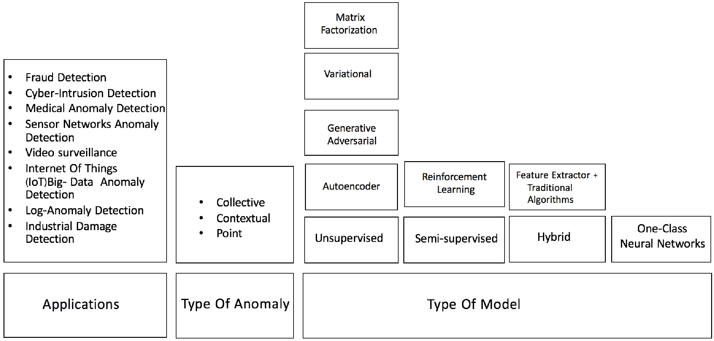
Anomaly Detection
Notes:
https://tongtianta.site/paper/39462 DEEP LEARNING FOR ANOMALY DETECTION: A SURVEY

Slide 5
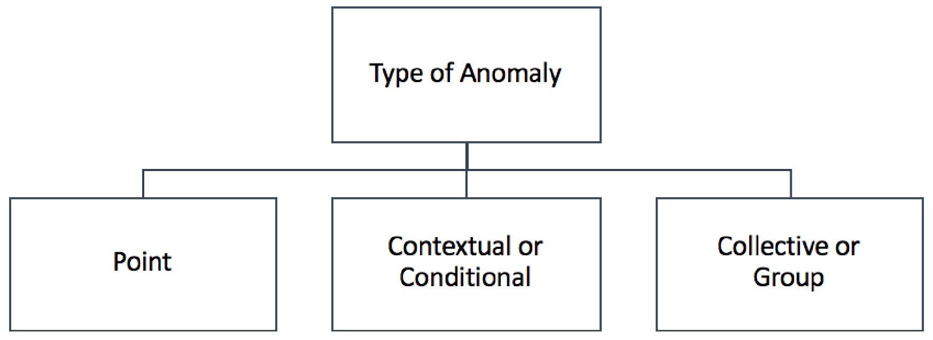
Anomaly Detection
Notes:
https://tongtianta.site/paper/39462 DEEP LEARNING FOR ANOMALY DETECTION: A SURVEY

Slide 6
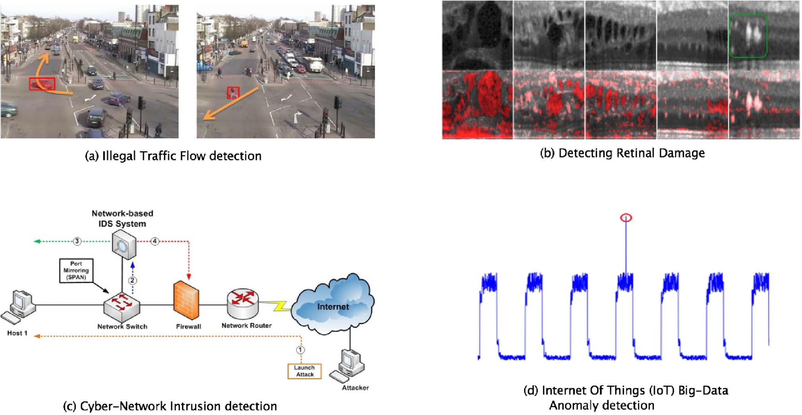
Anomaly Detection
Notes:
https://tongtianta.site/paper/39462 DEEP LEARNING FOR ANOMALY DETECTION: A SURVEY

Slide 7
Image-level anomaly detection
Classification target
Adversarially Learned One-Class Classifier for Novelty Detection [ALOCC] | Mohammad Sabokrou, et al. | [CVPR' 18]
Hierarchical Novelty Detection for Visual Object Recognition | Kibok Lee, et al. | [CVPR' 18]
Deep One-Class Classification | Lukas Ruff, el al. | [ICML' 18]
Deep Anomaly Detection with Outlier Exposure | Dan Hendrycks, et al. | [ICLR' 19]
Latent Space Autoregression for Novelty Detection | Davide Abati, et al. | [CVPR' 19]
OCGAN: One-Class Novelty Detection Using GANs With Constrained Latent Representations | Pramuditha Perera, et al. | [CVPR' 19]
Notes:
https://github.com/hoya012/awesome-anomaly-detection
https://www.dlology.com/blog/how-to-do-novelty-detection-in-keras-with-generative-adversarial-network/
https://github.com/khalooei/ALOCC-CVPR2018

Slide 8
Image-level anomaly detection
Segmentation target
Unsupervised Anomaly Detection with Generative Adversarial Networks to Guide Marker Discovery [AnoGAN] | Thomas Schlegl, et al. | [IPMI' 17]
Improving Unsupervised Defect Segmentation by Applying Structural Similarity to Autoencoders | Paul Bergmann, et al. | [arXiv' 18]
Deep Autoencoding Models for Unsupervised Anomaly Segmentation in Brain MR Images | Christoph Baur, et al. | [arXiv' 18]
AVID: Adversarial Visual Irregularity Detection | Mohammad Sabokrou, et al. | [arXiv' 18]
MVTec AD -- A Comprehensive Real-World Dataset for Unsupervised Anomaly Detection | Paul Bergmann, et al. | [CVPR' 19]
Exploiting Epistemic Uncertainty of Anatomy Segmentation for Anomaly Detection in Retinal OCT | Philipp Seeböck, et al. | [IEEE TMI' 19]
Notes:
https://github.com/hoya012/awesome-anomaly-detection

Slide 9
Anomaly Detection
GAN
AnoGAN 、f-AnoGAN、GANomaly、Skip-ganomaly、Efficient-GAN、fence GAN
Structured Representations
Patch GAN、 spatial VAE、structed based VAE
VAE
VAE+GAN AAE+GAN VAE+pixel CNN
loss
SSIM loss GAN loss perceptual loss
CNN+image inpianting
Unet+Partial CNN

Slide 10
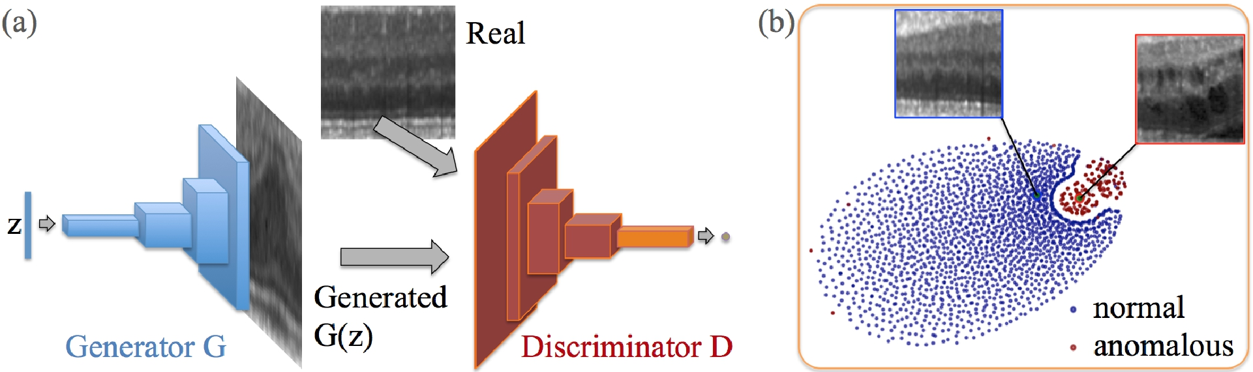
anoGAN for Unsupervised Anomaly Detection
(a) Deep convolutional generative adversarial network. (b) t-SNE embedding of normal (blue) and anomalous (red) images on the feature representation of the last convolution layer (orange in (a)) of the discriminator
Schlegl, Thomas, et al. "Unsupervised anomaly detection with generative adversarial networks to guide marker discovery." International Conference on Information Processing in Medical Imaging. Springer, Cham, 2017.
Notes:
http://tongtianta.site/paper/4538

Slide 11
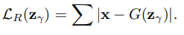
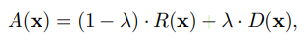
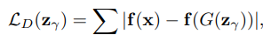
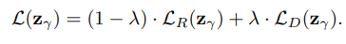
anoGAN for Unsupervised Anomaly Detection
residual loss:
Discrimination Loss:
Only the coeﬃcients of z are adapted via backpropagation. The trained parameters of the generator and discriminator are kept ﬁxed
Schlegl, Thomas, et al. "Unsupervised anomaly detection with generative adversarial networks to guide marker discovery." International Conference on Information Processing in Medical Imaging. Springer, Cham, 2017.

Slide 12
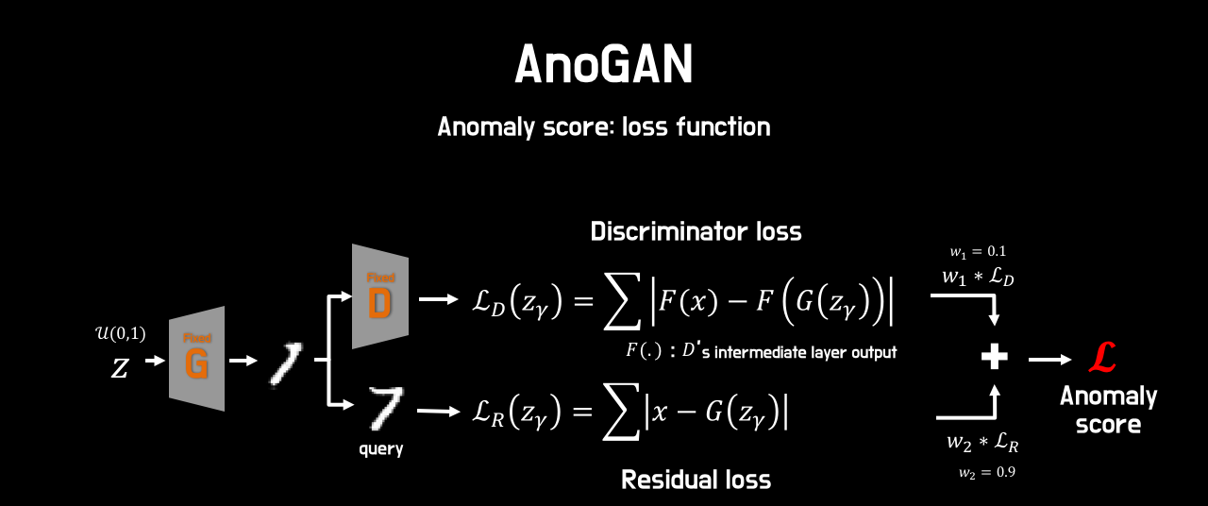
anoGAN for Unsupervised Anomaly Detection
Schlegl, Thomas, et al. "Unsupervised anomaly detection with generative adversarial networks to guide marker discovery." International Conference on Information Processing in Medical Imaging. Springer, Cham, 2017.

Slide 13
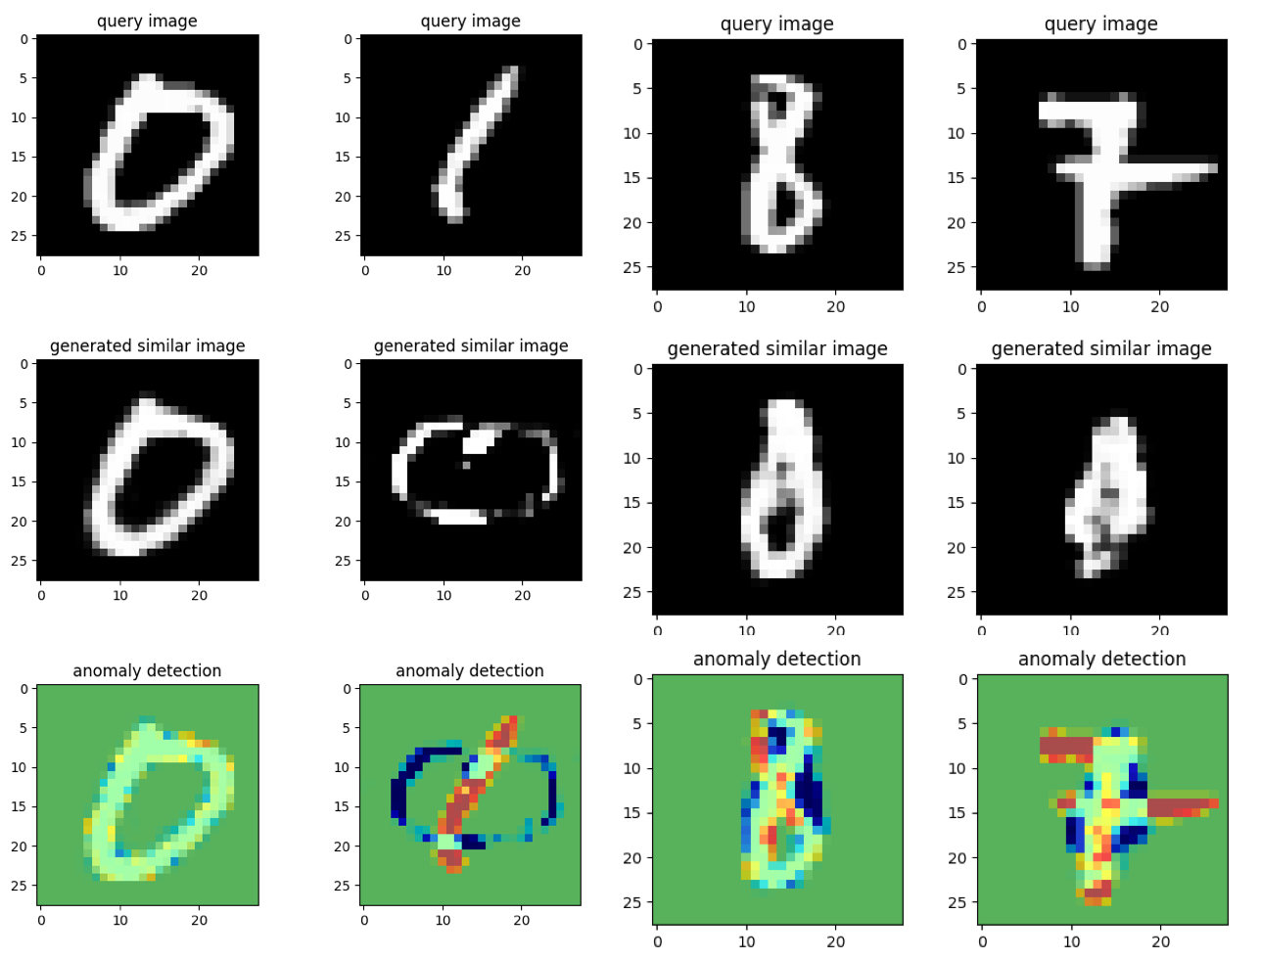
anoGAN for Unsupervised Anomaly Detection
Notes:
https://github.com/oyxhust/wgan-gp-anomaly (wgan-gp)
https://github.com/fuchami/ANOGAN (DCGAN)
https://github.com/kosyoshida/simple-keras https://github.com/tkwoo/anogan-keras
AnoGAN(code, keras) : https://github.com/yjucho1/anoGAN AnoGAN(code, tf) : https://github.com/LeeDoYup/AnoGAN

Slide 14
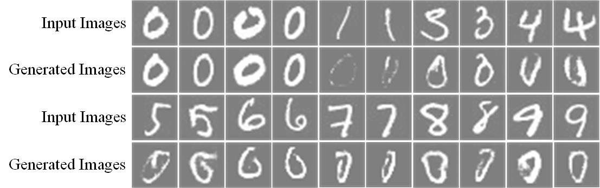
anoGAN for Unsupervised Anomaly Detection
Schlegl, Thomas, et al. "Unsupervised anomaly detection with generative adversarial networks to guide marker discovery." International Conference on Information Processing in Medical Imaging. Springer, Cham, 2017.
Notes:
https://github.com/oyxhust/wgan-gp-anomaly (wgan-gp)
https://github.com/fuchami/ANOGAN (DCGAN)
https://github.com/kosyoshida/simple-keras

Slide 15
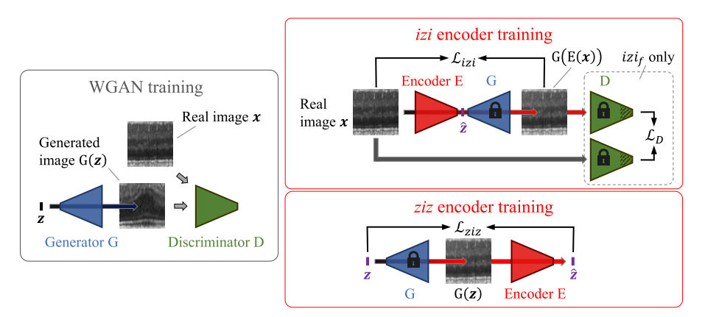
f-AnoGAN
Schlegl, Thomas, et al. "f-AnoGAN: Fast unsupervised anomaly detection with generative adversarial networks." Medical image analysis 54 (2019): 30-44.
Notes:
https://github.com/tSchlegl/f-AnoGAN

Slide 16
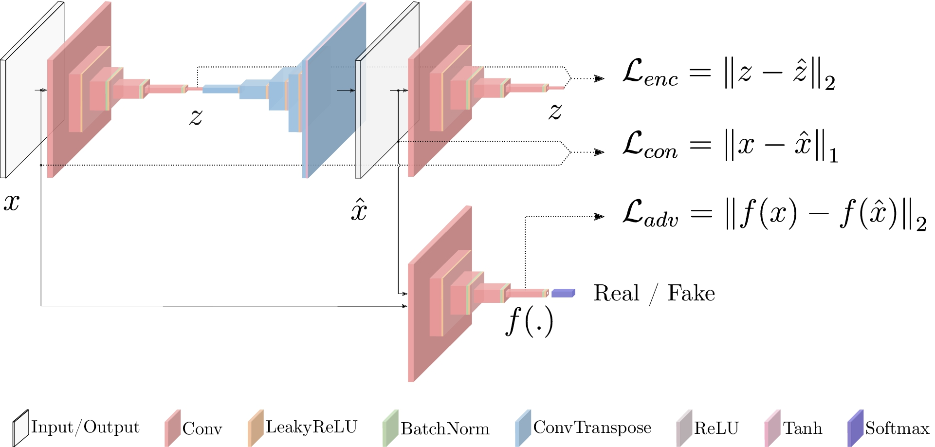
GANomaly
Akcay, Samet, Amir Atapour-Abarghouei, and Toby P. Breckon. "Ganomaly: Semi-supervised anomaly detection via adversarial training." Asian Conference on Computer Vision. Springer, Cham, 2018.
Notes:
https://github.com/WellenWoo/GANomaly-pytorch
https://github.com/aarthipriyar/GAN
https://github.com/samet-akcay/ganomaly
https://github.com/mimirobo/retina_ganomaly
https://github.com/samet-akcay/ganomaly
https://github.com/ucbtns/medgan
https://github.com/SunnerLi/GANomaly2D
https://github.com/gewenchao/anomaly-detection-semi-supervision
https://github.com/chychen/tf2-ganomaly
https://researchcode.com/code/2843279368/ganomaly-semi-supervised-anomaly-detection-via-adversarial-training/

Slide 17
GANomaly
Akcay, Samet, Amir Atapour-Abarghouei, and Toby P. Breckon. "Ganomaly: Semi-supervised anomaly detection via adversarial training." Asian Conference on Computer Vision. Springer, Cham, 2018.
Notes:
https://github.com/WellenWoo/GANomaly-pytorch
https://github.com/aarthipriyar/GAN
https://github.com/samet-akcay/ganomaly
https://github.com/Scott1123/GANomaly
https://github.com/SnowMasaya/Efficient_GAN-Based_Anomaly_Detection_Keras

Slide 18
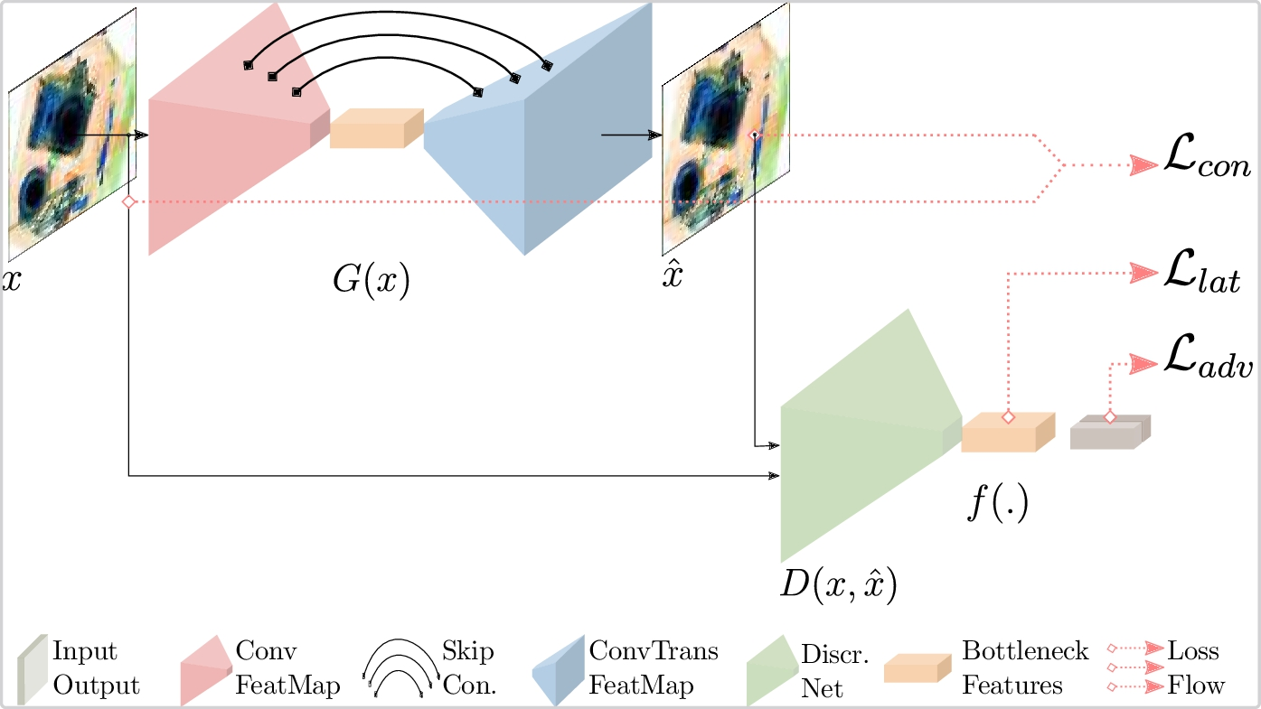
Skip-ganomaly
S. Akçay, A. Atapour-Abarghouei, T. P. Breckon, Skip-GANomaly: Skip Connected and Adversarially Trained Encoder-Decoder Anomaly Detection, in: International Joint Conference on Neural Networks (IJCNN), IEEE, 2019
Notes:
https://github.com/samet-akcay/skip-ganomaly

Slide 19
Geometric Transformations
Notes:
https://arxiv.org/abs/1805.10917v2
https://github.com/izikgo/AnomalyDetectionTransformations

Slide 20
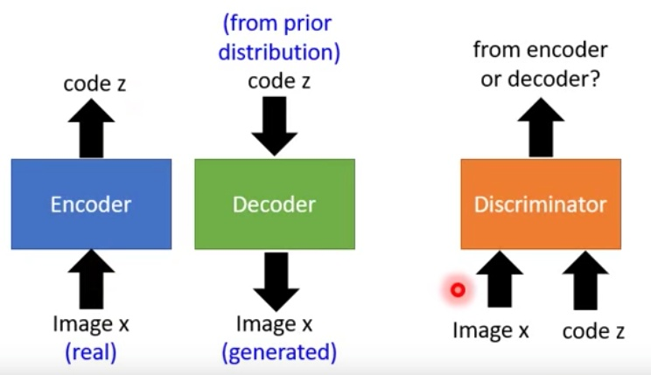
Efficient-GAN
Zenati, Houssam, et al. "Efficient gan-based anomaly detection." arXiv preprint arXiv:1802.06222 (2018).
Notes:
https://github.com/houssamzenati/Efficient-GAN-Anomaly-Detection
https://arxiv.org/abs/1904.02426v2 Efficient GAN-based method for cyber-intrusion detection
https://github.com/Forcrush/Efficient-GAN-based-method-for-cyber-intrusion基于GAN的高效网络入侵方法
https://tongtianta.site/paper/28541 Efficient GAN-Based Anomaly Detection
https://github.com/houssamzenati/Efficient-GAN-Anomaly-Detection
https://github.com/SnowMasaya/Efficient_GAN-Based_Anomaly_Detection_Keras
https://github.com/acv0209/Efficient_GAN

Slide 21
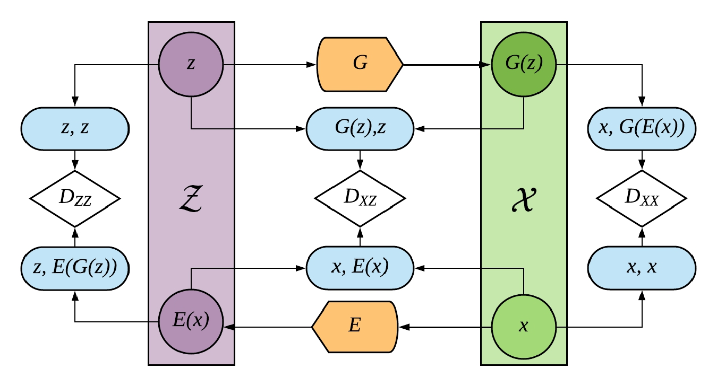
Adversarially-Learned-Anomaly-Detection
Notes:
https://arxiv.org/abs/1812.02288 Adversarially Learned Anomaly Detection
https://github.com/houssamzenati/Adversarially-Learned-Anomaly-Detection
https: //github.com/houssamzenati/Adversarially-Learned-Anomaly-Detection
https://tongtianta.site/paper/29763 Adversarially Learned Anomaly Detection

Slide 22
Adversarially Learned Inference
Notes:
https://ishmaelbelghazi.github.io/ALI/
https://blog.csdn.net/StreamRock/article/details/81905648

Slide 23
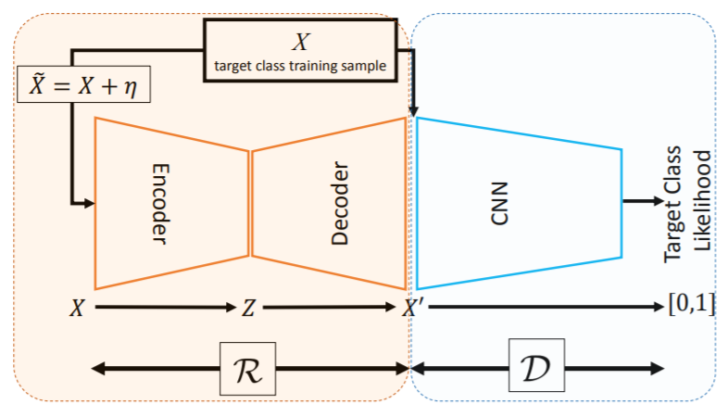
Adversarially Learned One-Class Classifier for Novelty Detection
Sabokrou, Mohammad, et al. "Adversarially learned one-class classifier for novelty detection." Proceedings of the IEEE Conference on Computer Vision and Pattern Recognition. 2018.
Notes:
https://arxiv.org/pdf/1802.09088.pdf

Slide 24
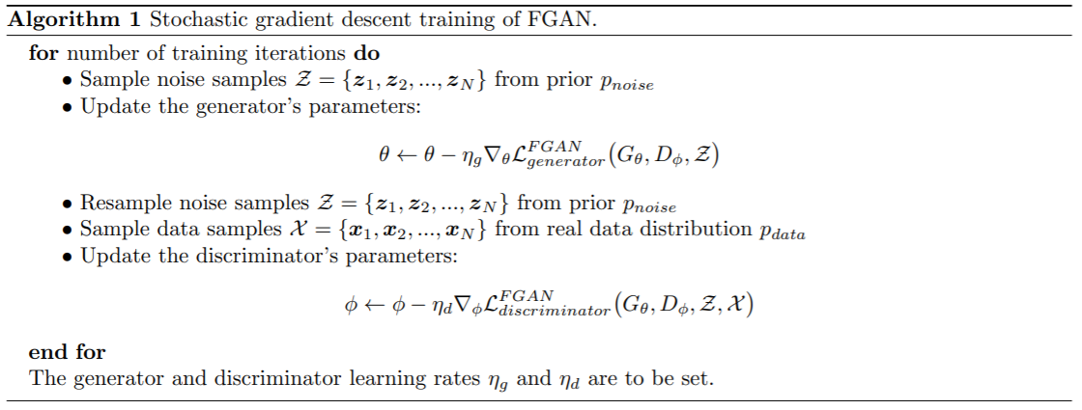
Fence GAN
Ngo, Cuong Phuc, et al. "Fence GAN: Towards Better Anomaly Detection." arXiv preprint arXiv:1904.01209 (2019).
Notes:
https://tongtianta.site/paper/36724 Fence GAN: Towards Better Anomaly Detection
https://arxiv.org/abs/1904.01209

Slide 25
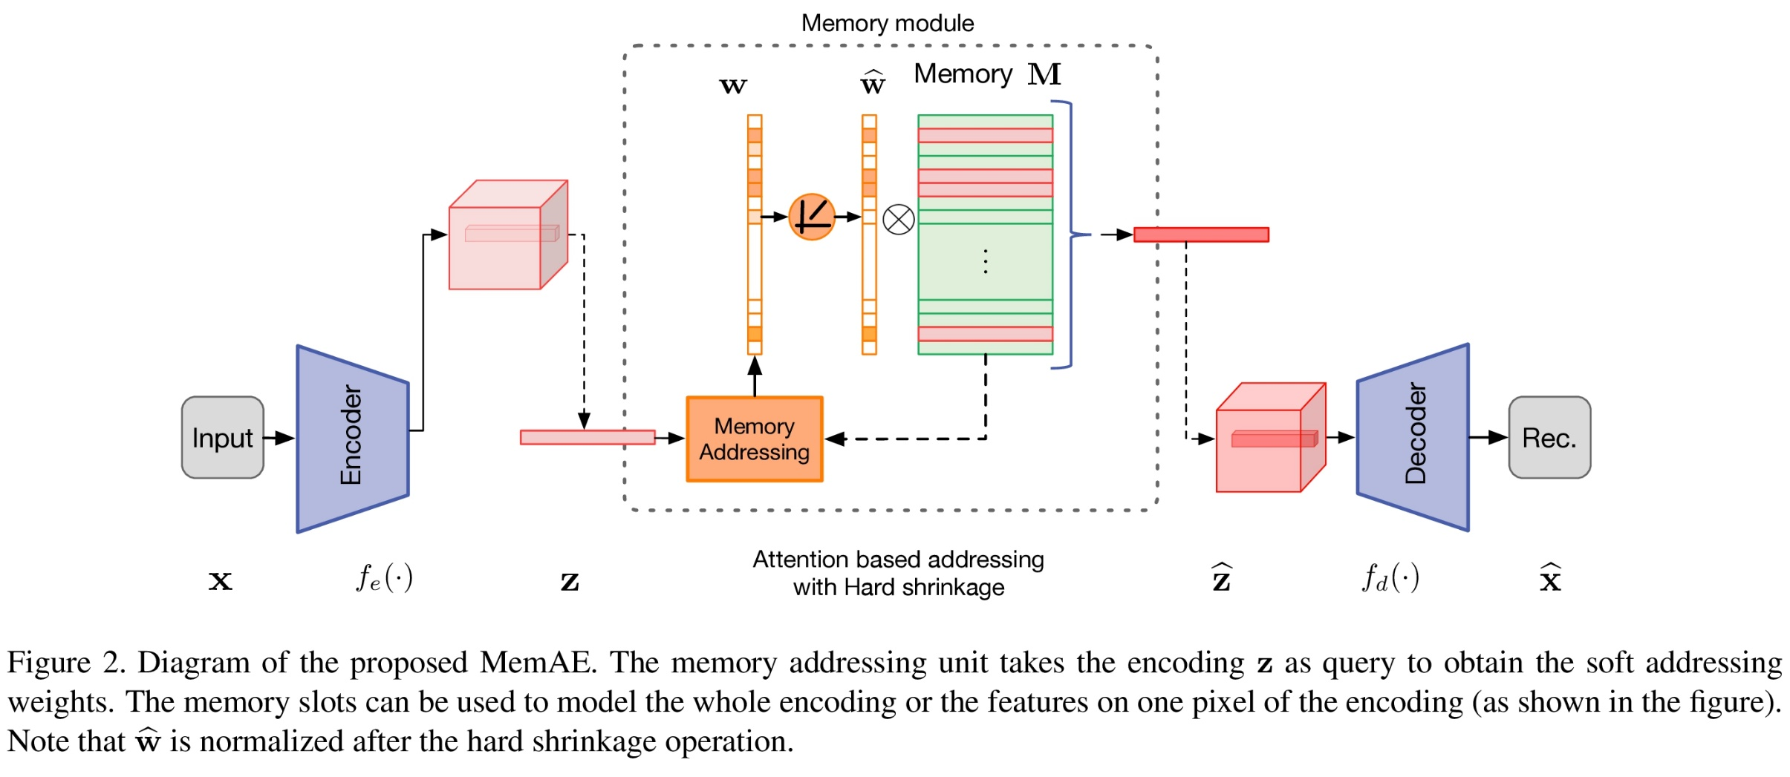
MemAE
Gong, Dong, et al. "Memorizing Normality to Detect Anomaly: Memory-augmented Deep Autoencoder for Unsupervised Anomaly Detection." arXiv preprint arXiv:1904.02639 (2019).
Notes:
https://github.com/h19920918/memae
Memorizing Normality to Detect Anomaly: Memory-augmented Deep Autoencoder for Unsupervised Anomaly Detection (MemAE)
https://tongtianta.site/paper/37335 Memorizing Normality to Detect Anomaly: Memory-augmented Deep Autoencoder for Unsupervised Anomaly Detection
https://github.com/donggong1/memae-anomaly-detection
https://arxiv.org/pdf/1904.02639.pdf

Slide 26
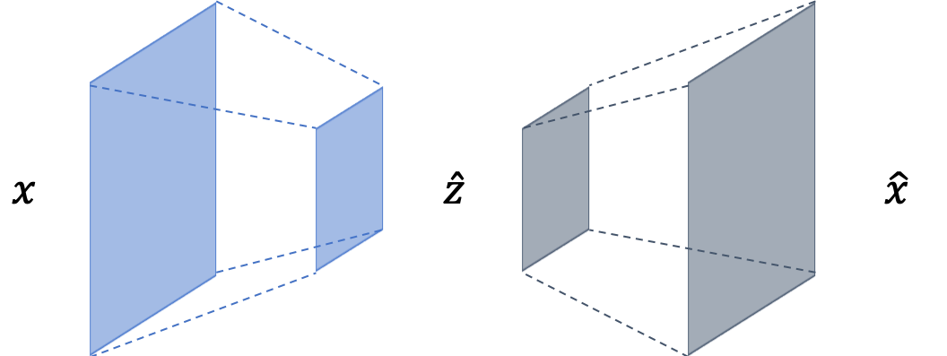
CVAE
Notes:
https://github.com/YeongHyeon/CVAE-AnomalyDetection
https://github.com/ninnart-fuengfusin/convolutional-anomaly-detection-autoencoder
https://github.com/shinmura0/AutoEncoder_vs_MetricLearning
https://github.com/bianjiang1234567/CVAE-GAN-BASED-Anomaly-Detection A Novel and Efficient CVAE-GAN-BASED Approach with Informative Manifold for Semi-Supervised Anomaly Detection
https://ieeexplore.ieee.org/stamp/stamp.jsp?tp=&arnumber=8727990
https://ieeexplore.ieee.org/stamp/stamp.jsp?arnumber=8727990

Slide 27
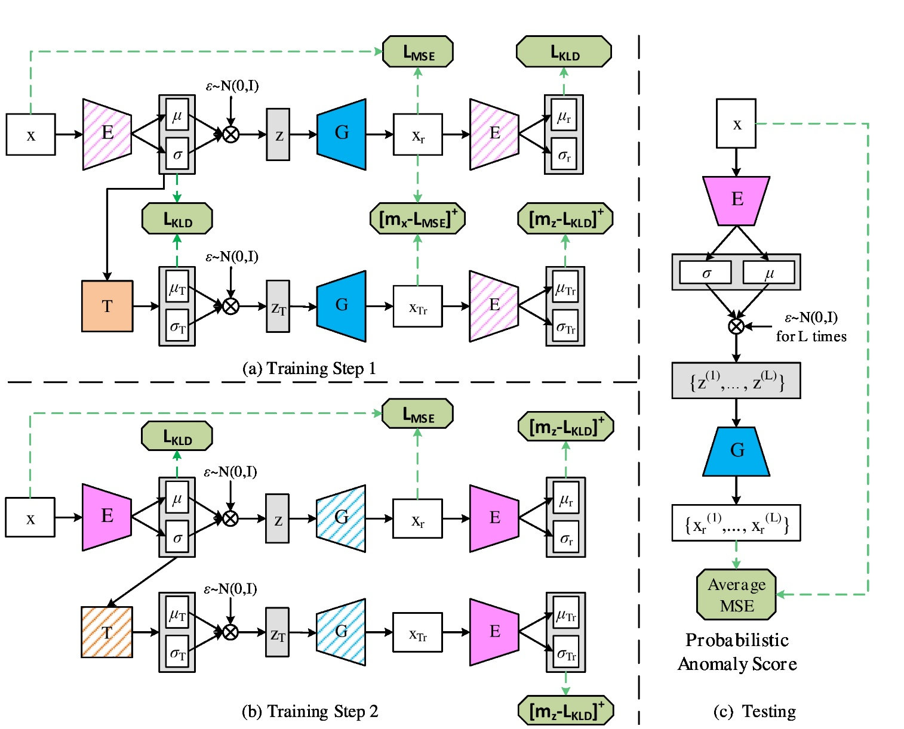
adVAE
Wang, Xuhong, et al. "Self-adversarial Variational Autoencoder with Gaussian Anomaly Prior Distribution for Anomaly Detection." arXiv preprint arXiv:1903.00904 (2019).
Notes:
https://github.com/YeongHyeon/adVAE
https://github.com/YeongHyeon/CVAE-AnomalyDetection
Self-Adversarial Variational Autoencoder with Gaussian Anomaly Prior Distribution for Anomaly Detection
https://tongtianta.site/paper/52769 Self-adversarial Variational Autoencoder with Gaussian Anomaly Prior Distribution for Anomaly Detection
https://github.com/WangXuhongCN/adVAE adVAE: a Self-adversarial Variational Autoencoder with Gaussian Anomaly Prior Knowledge for Anomaly Detection

Slide 28
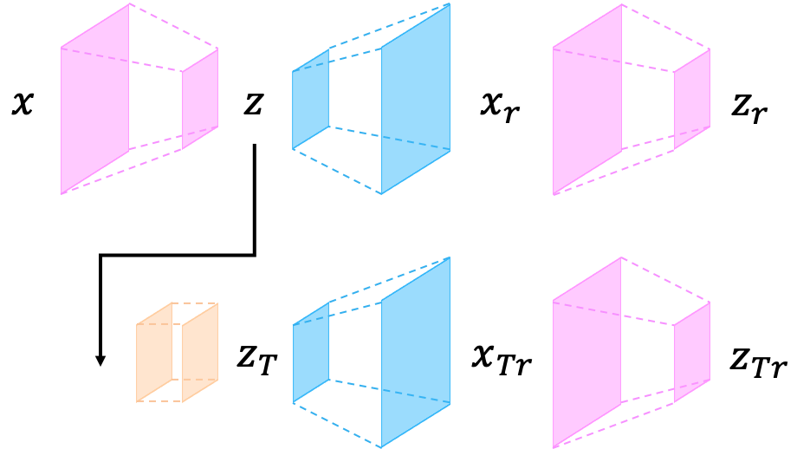
adVAE
Notes:
https://github.com/YeongHyeon/adVAE
https://github.com/YeongHyeon/CVAE-AnomalyDetection
Self-Adversarial Variational Autoencoder with Gaussian Anomaly Prior Distribution for Anomaly Detection
https://github.com/WangXuhongCN/adVAE
https://tongtianta.site/paper/52769

Slide 29
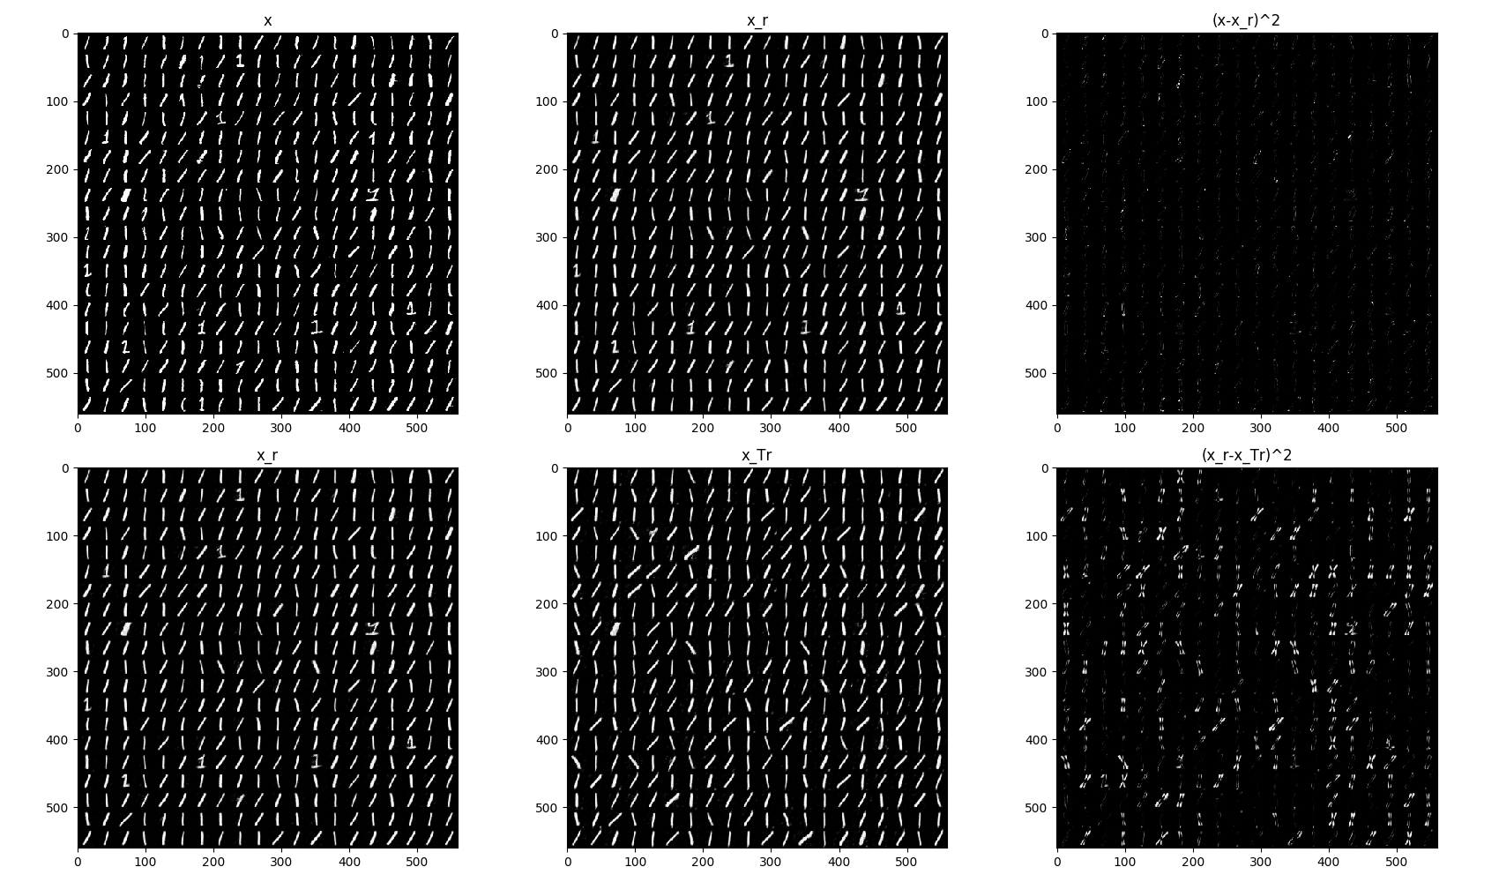
adVAE
Notes:
https://github.com/YeongHyeon/adVAE
https://github.com/YeongHyeon/CVAE-AnomalyDetection
Self-Adversarial Variational Autoencoder with Gaussian Anomaly Prior Distribution for Anomaly Detection
https://tongtianta.site/paper/52769
https://github.com/WangXuhongCN/adVAE a Self-adversarial Variational Autoencoder with Gaussian Anomaly Prior Knowledge for Anomaly Detection

Slide 30
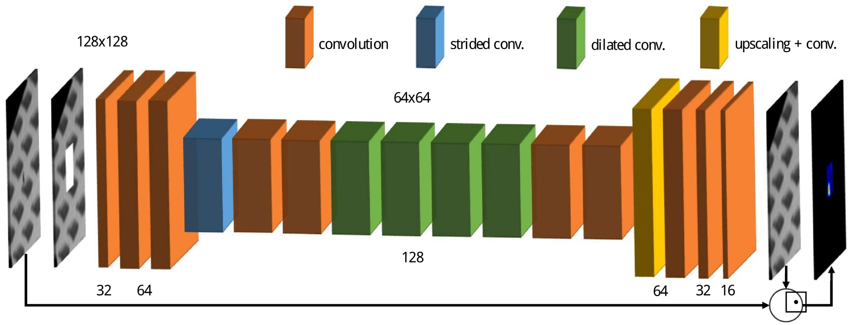
CompactCNN
Notes:
https://github.com/msminhas93/CompactCNN
A Compact Convolutional Neural Network for Textured Surface Anomaly Detection
https://tongtianta.site/paper/51924
http://arxiv.org/pdf/1811.06861v1.pdf
https://www.semanticscholar.org/paper/A-Compact-Convolutional-Neural-Network-for-Textured-Racki-Tomazevic/17d3f90cb63fbac50a5e49b8a46e633ec1f526fd#extracted

Slide 31
Image Completion
Notes:
https://arxiv.org/pdf/1811.06861.pdf Anomaly Detection using Deep Learning based Image Completion
https://github.com/oezguensi/anomaly-detection-image-completion

Slide 32
Doping
Lim, Swee Kiat, et al. "Doping: Generative data augmentation for unsupervised anomaly detection with gan." 2018 IEEE International Conference on Data Mining (ICDM). IEEE, 2018.
Notes:
https://github.com/greentfrapp/doping

Slide 33
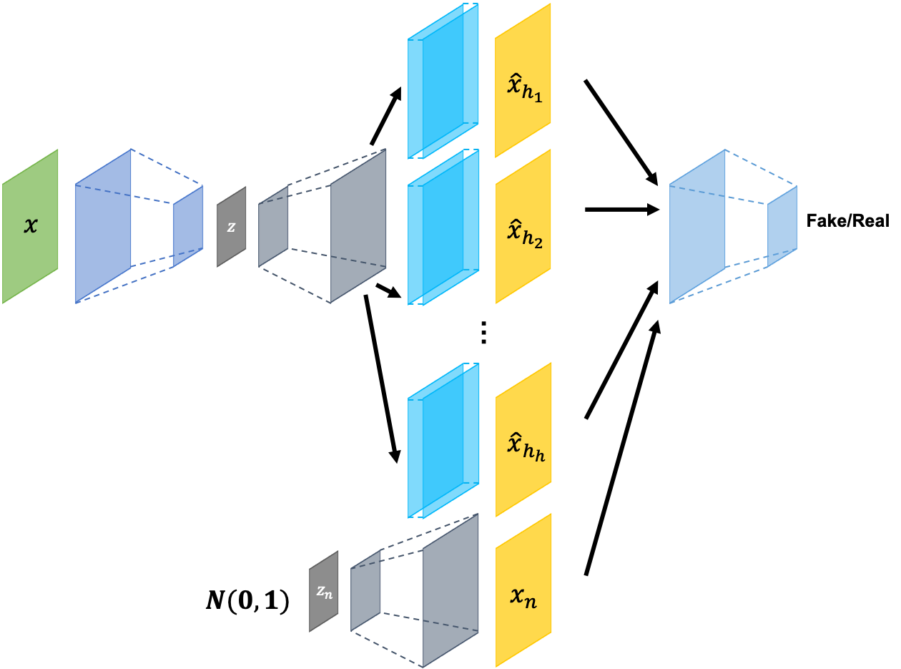
ConAD
Notes:
https://github.com/YeongHyeon/ConAD Anomaly Detection With Multiple-Hypotheses Predictions
https://arxiv.org/abs/1810.13292
https://github.com/YeongHyeon/CVAE-AnomalyDetection
https://tongtianta.site/paper/64540 Anomaly Detection With Multiple-Hypotheses Predictions

Slide 34
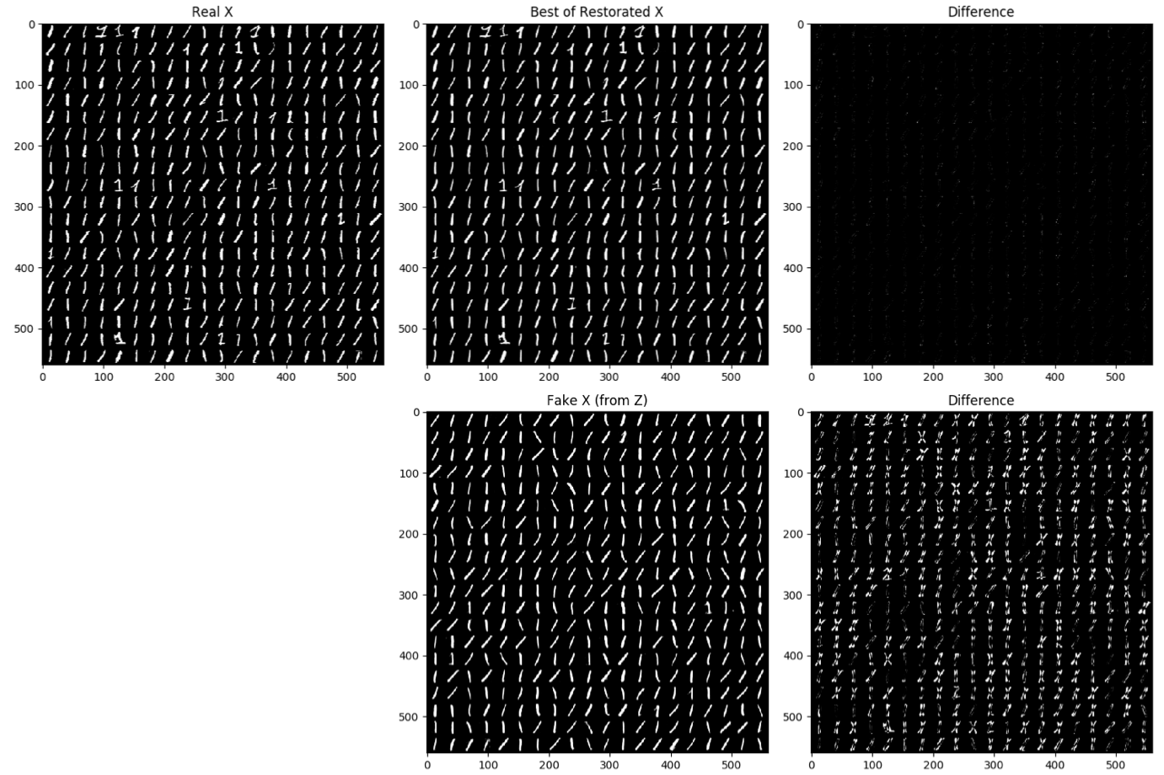
ConAD
Notes:
https://github.com/YeongHyeon/ConAD Anomaly Detection With Multiple-Hypotheses Predictions
https://arxiv.org/abs/1810.13292
https://github.com/YeongHyeon/CVAE-AnomalyDetection

Slide 35
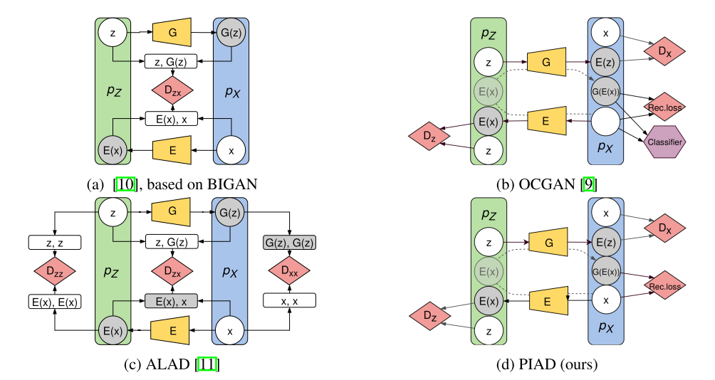
Perceptual Image Anomaly Detection
Notes:
Perceptual Image Anomaly Detection

Slide 36
Adversarially Learned Anomaly Detection
Adversarially Learned Anomaly Detection" (authors: Houssam Zenati*, Manon Romain*, Chuan Sheng Foo*, Bruno Lecouat, Vijay Ramaseshan Chandrasekhar)
Notes:
https://github.com/houssamzenati/Adversarially-Learned-Anomaly-Detection

Slide 37
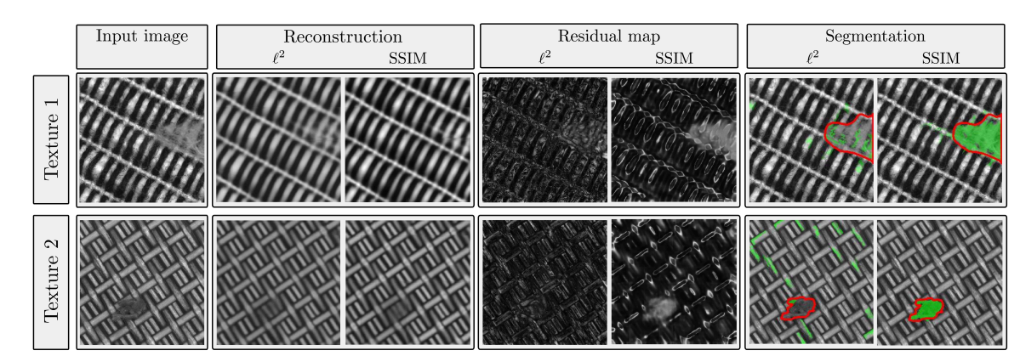
SSIM loss
Bergmann, Paul, et al. "Improving Unsupervised Defect Segmentation by Applying Structural Similarity to Autoencoders." arXiv preprint arXiv:1807.02011 (2018).
Notes:
https://github.com/cheapthrillandwine/Improving_Unsupervised_Defect_Segmentation
https://arxiv.org/abs/1807.02011v3
https://tongtianta.site/paper/16206 Improving Unsupervised Defect Segmentation by Applying Structural Similarity to Autoencoders
Feature Matching Autoencoder
https://arxiv.org/abs/1602.02644 Generating Images with Perceptual Similarity Metrics based on Deep Networks

Slide 38
patch_gan_alocc
Notes:
https://github.com/jingkunchen/patch_gan_alocc

Slide 39
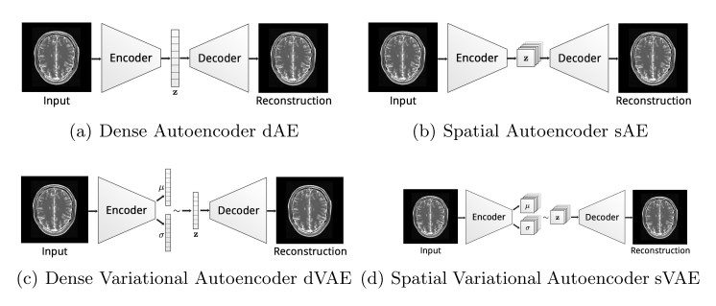
Spatial VAE
Baur, Christoph, et al. "Deep autoencoding models for unsupervised anomaly segmentation in brain mr images." International MICCAI Brainlesion Workshop. Springer, Cham, 2018.
Notes:
https://github.com/divelab/svae
https://github.com/tbepler/spatial-VAE
http://tongtianta.site/paper/61488
http://tongtianta.site/paper/61141
https://github.com/bumuckl/AutoencodersForUnsupervisedAnomalyDetection AutoencodersForUnsupervisedAnomalyDetection
https://arxiv.org/abs/1804.04488 Deep Autoeoncoding Models for Unsupervised Anomaly Detection in Brain MR Images

Slide 40
Deep Structured Energy Based Models
Notes:
Iterative energy-based projection on a normal data manifold for anomaly localization http://tongtianta.site/paper/59419
Deep structured energy-based image inpainting
http://tongtianta.site/paper/25792 Deep structured energy-based image inpainting
Deep Structured Energy Based Models for Anomaly Detection https://arxiv.org/abs/1605.07717
https://tongtianta.site/paper/63419
http://proceedings.mlr.press/v48/zhai16.pdf
https://github.com/yli96/DSEBM Deep Structured Energy Based Model

Slide 41
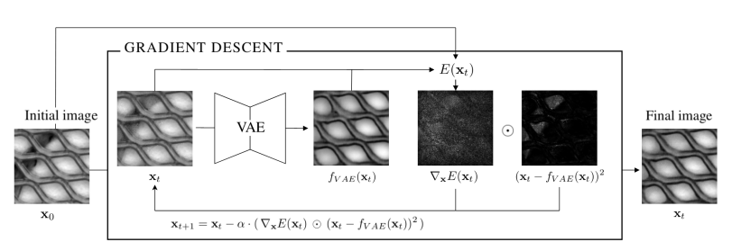
Structured Energy-Based VAE
Notes:
Iterative energy-based projection on a normal data manifold for anomaly localization http://tongtianta.site/paper/59419
Deep structured energy-based image inpainting
http://tongtianta.site/paper/25792 Deep structured energy-based image inpainting
Deep Structured Energy Based Models for Anomaly Detection https://arxiv.org/abs/1605.07717
https://tongtianta.site/paper/63419

Slide 42
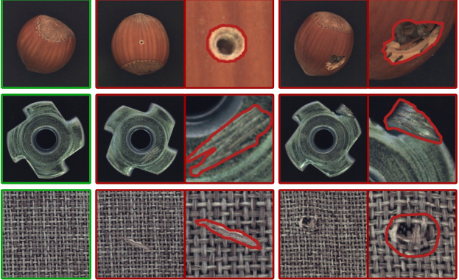
DataSet
Bergmann, Paul, et al. "MVTec AD--A Comprehensive Real-World Dataset for Unsupervised Anomaly Detection." Proceedings of the IEEE Conference on Computer Vision and Pattern Recognition. 2019.
Notes:
https://tongtianta.site/paper/43891 MVTec AD — A Comprehensive Real-World Dataset for Unsupervised Anomaly Detection
https://tongtianta.site/paper/39253 A Comprehensive Real-World Dataset for Unsupervised Anomaly Detection

Slide 43
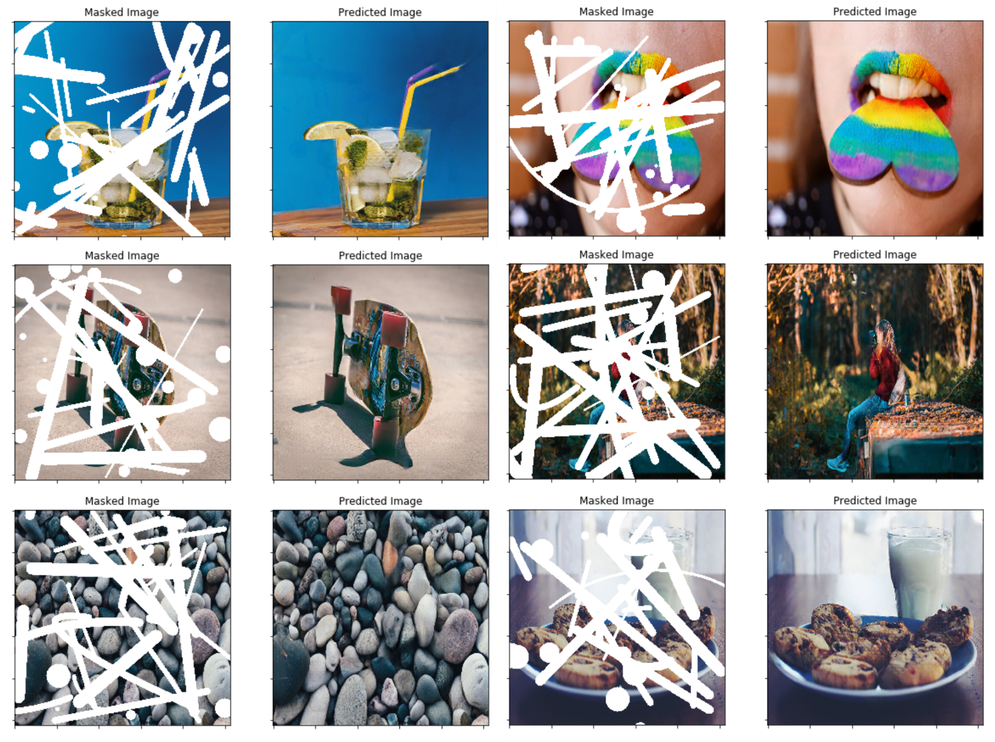
Partial Convolutions for Image Inpainting
Liu, Guilin, et al. "Image inpainting for irregular holes using partial convolutions." Proceedings of the European Conference on Computer Vision (ECCV). 2018.
Notes:
https://qiita.com/shinmura0/items/742adb4faefcfc8dd5cb
https://github.com/shinmura0/PConv-Keras

Slide 44
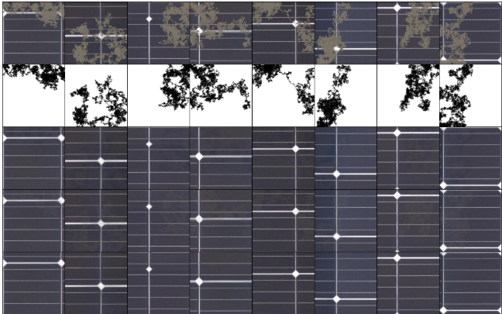
Partial Convolutions
Notes:
https://qiita.com/shinmura0/items/742adb4faefcfc8dd5cb
https://github.com/shinmura0/PConv-Keras

Slide 45
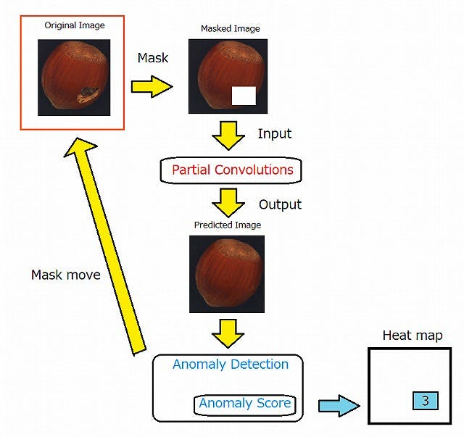
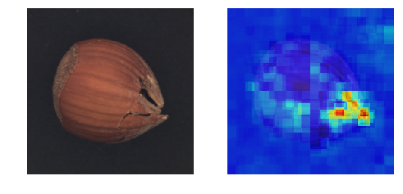
Ano-Unet
Notes:
https://qiita.com/shinmura0/items/742adb4faefcfc8dd5cb
https://github.com/shinmura0/PConv-Keras

Slide 46
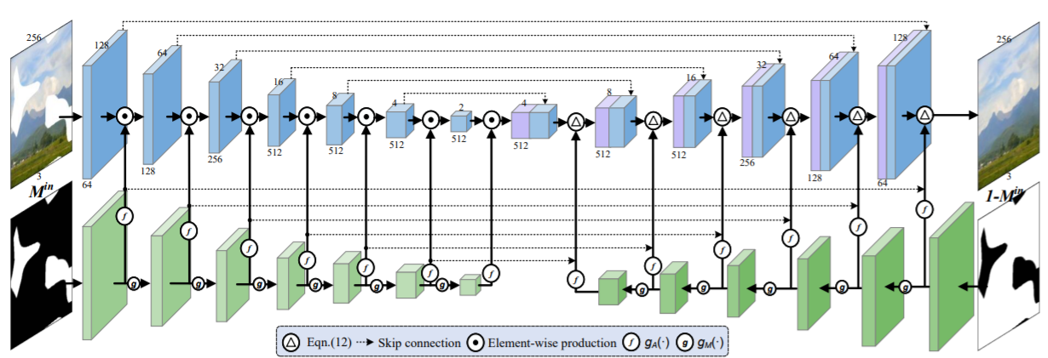
Pluralistic-Inpainting
Xie, Chaohao, et al. "Image Inpainting with Learnable Bidirectional Attention Maps." arXiv preprint arXiv:1909.00968 (2019).

Slide 47
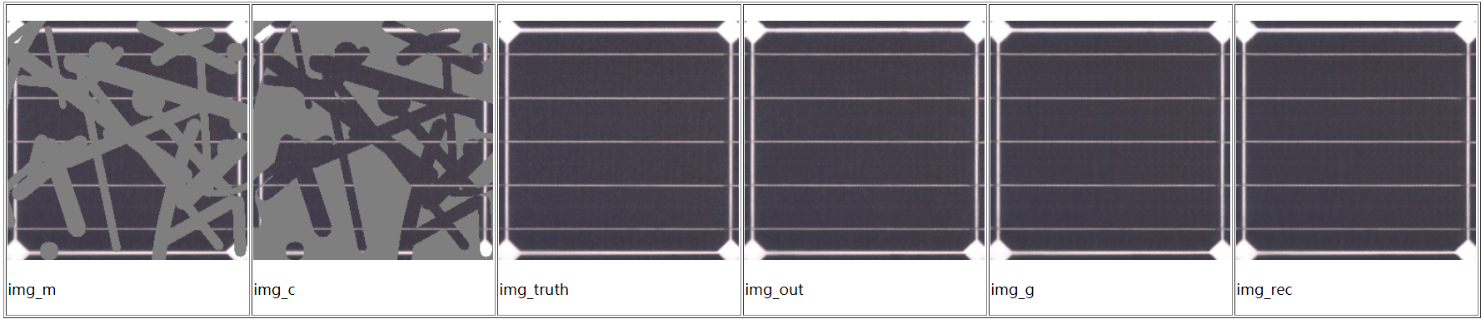
Pluralistic-Inpainting
Xie, Chaohao, et al. "Image Inpainting with Learnable Bidirectional Attention Maps." arXiv preprint arXiv:1909.00968 (2019).

Slide 48
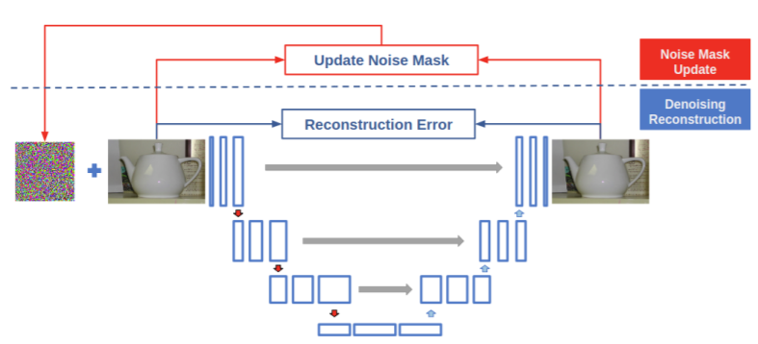
PNUNet
Kimura, Masanari. "PNUNet: Anomaly Detection using Positive-and-Negative Noise based on Self-Training Procedure." arXiv preprint arXiv:1905.10939 (2019).
Notes:
https://arxiv.org/pdf/1905.10939v1.pdf
PNUNet: Anomaly Detection using Positive-and-Negative Noise based on Self-Training Procedure

Slide 49
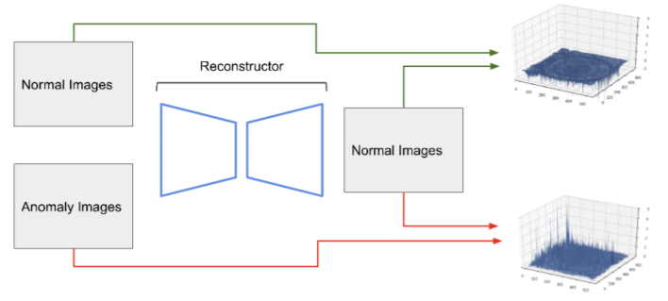
PNUNet
Kimura, Masanari. "PNUNet: Anomaly Detection using Positive-and-Negative Noise based on Self-Training Procedure." arXiv preprint arXiv:1905.10939 (2019).
Notes:
https://arxiv.org/pdf/1905.10939v1.pdf
PNUNet: Anomaly Detection using Positive-and-Negative Noise based on Self-Training Procedure

Slide 50
Anomaly Detection in Images
Notes:
https://arxiv.org/abs/1905.13147v1 Anomaly Detection in Images
https://tongtianta.site/paper/55164

Slide 51
Robust Anomaly Detection in Images using Adversarial Autoencoders
Notes:
https://arxiv.org/pdf/1901.06355v1.pdf

Slide 52
oc-cnn
Notes:
https://github.com/otkupjnoz/oc-cnn
https://arxiv.org/pdf/1901.08688v1.pdf

Slide 53
Unsupervised Adversarial Image Reconstruction
Notes:
Anonymous code for https://openreview.net/forum?id=BJg4Z3RqF7
https://github.com/UNIR-Anonymous/UNIR

Slide 54
autoencoder_anomaly_subset
Notes:
https://github.com/usersubsetscan/autoencoder_anomaly_subset
Unsupervised adversarial attack detection in autoencoders activations and Reconstruction Error with Subset Scanning

